Slide 1

Introduction to Operating Systems
Introduction to Operating Systems
Module - I
Dr. A.Padmavathi
Assistant Professor(SG)
Department of Computer Science and Engineering
Amrita School of Engineering, Chennai
Module - I

Slide 2
Lecture - 1
Introduction to Operating Systems

Slide 3
Contents
What is an operating system?
Operating system goals
What does operating systems do?
Parts of operating system
What is Kernel
Functions of operating systems

Slide 4
What is an operating system (OS)?
A program that acts as an intermediary between a user of a computer and the computer hardware.
In simple words, OS is an interface between user and hardware (CPU, I/O, RAM).
OS is a program (software) that manages the computer hardware.
It includes all programs that are associated with the operation of the system (computer).
OS resides in hard disc, but on system booting, it is copied to RAM.

Slide 5
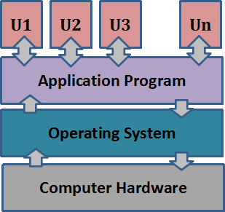
Computer System Components
Hardware – basic computing resources (CPU, memory, I/O devices).
Operating system – controls and coordinates the use of the hardware among various application programs for different users.
Applications programs – define the ways in which system resources are used to solve the computing problems of the users
Users (people, machines, other computers).
U1, U2….Un are users
Abstract view of the components of a computer system

Slide 6
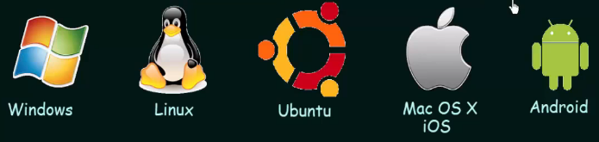
Various Operating systems
and many more……..

Slide 7
Quick question
Why there is a need of an operating system?
If there is no operating system, then the user need to write separate program to access each of the hardware.
Eg. In order to print a document, the user need to write a program to invoke the printer and do the printing.

Slide 8
Operating System Goals
Make the computer system convenient to use.
CONVINIENCE (Windows OS acquired 95% market)
Execute user programs and make solving user problems easier.
EFFICIENCY/THROUGHPUT (Linux)
Throughput is number of tasks executed per unit time

Slide 9
Parts of operating system
Kernel (heart of OS)
Device drivers (to communicate with system hardware)
User interface (allows a user to enter and receive information)
System libraries (An organized collection of computer programs that is maintained on-line with a computer system by being held on a secondary storage device)
System utilities ( manage, maintain and control computer resources)

Slide 10
Quick questions
Are application programs eg. Excel, chrome etc. are part of OS?
No
OS (Kernel) is helping in running these processes
If any process wants to communicate with any hardware devices, it uses system calls.
Why do we need an interface (OS)? Why not the user directly communicate with the hardware?
Many problems such as memory access, resource conflict etc. will happen

Slide 11
Kernel
Kernel is the heart of OS
Portion of the OS code that is always resident in the main memory (RAM)
Functions of Kernel
Process management
Memory management
File system management
Protection & security
Device management
Inter process communication etc.

Slide 12
OS & Kernel
Windows OS – Windows NT is the Kernel (more than 75% market share)
Mac OS – XNU is the Kernel (around 19% market share)
Ubuntu OS – Red hat is the Kernel (Linux 1.6% market share for desktop computers)
In server class machines, Linux is used and more than 70% market share is acquired by Linux
In smart watches, smart phones, cars, smart TV etc. Linux Kernel is used.

Slide 13
Quick question
Can we have an OS without Kernel?
No
Can we have Kernel without an OS?
Yes

Slide 14
Functions of operating systems
Resource management
Process management
Storage management
Memory management
File system management
Protection & security
Inter process communication etc.
In other words, functions of Kernel + CLI(command line interface) and GUI (graphical user interface) for user interaction with the system
OS provides system utilities and system libraries

Slide 15
Thank you!!

